Slide 1
Lecture: Tools of ICT & Computer Systems
By: Lecturer CS

Slide 2
Tools of ICT
1. Computer System
2. Mobile System
3. Satellite System
4. Radio System

Slide 3
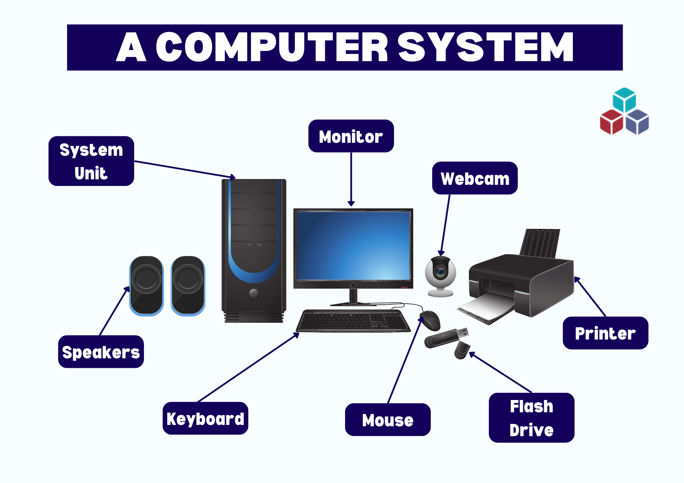

Slide 4
Tools of ICT→ Computer System
A computer system is the central tool of ICT, combining hardware (physical parts) and software (programs and applications).
It allows data input, storage, processing, and output, which forms the backbone of all ICT services.
Examples:
Personal computers (PCs): Used by individuals for office, study, and entertainment.
Servers: Used by organizations to manage websites, emails, and databases.
Supercomputers: Used in advanced research like space missions, artificial intelligence, and climate prediction.

Slide 5
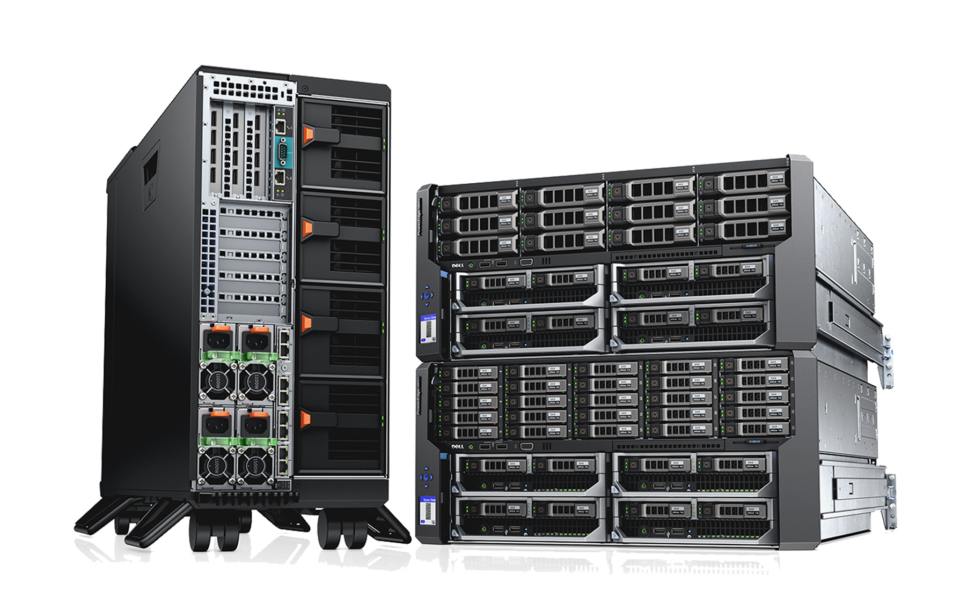
Server

Slide 6
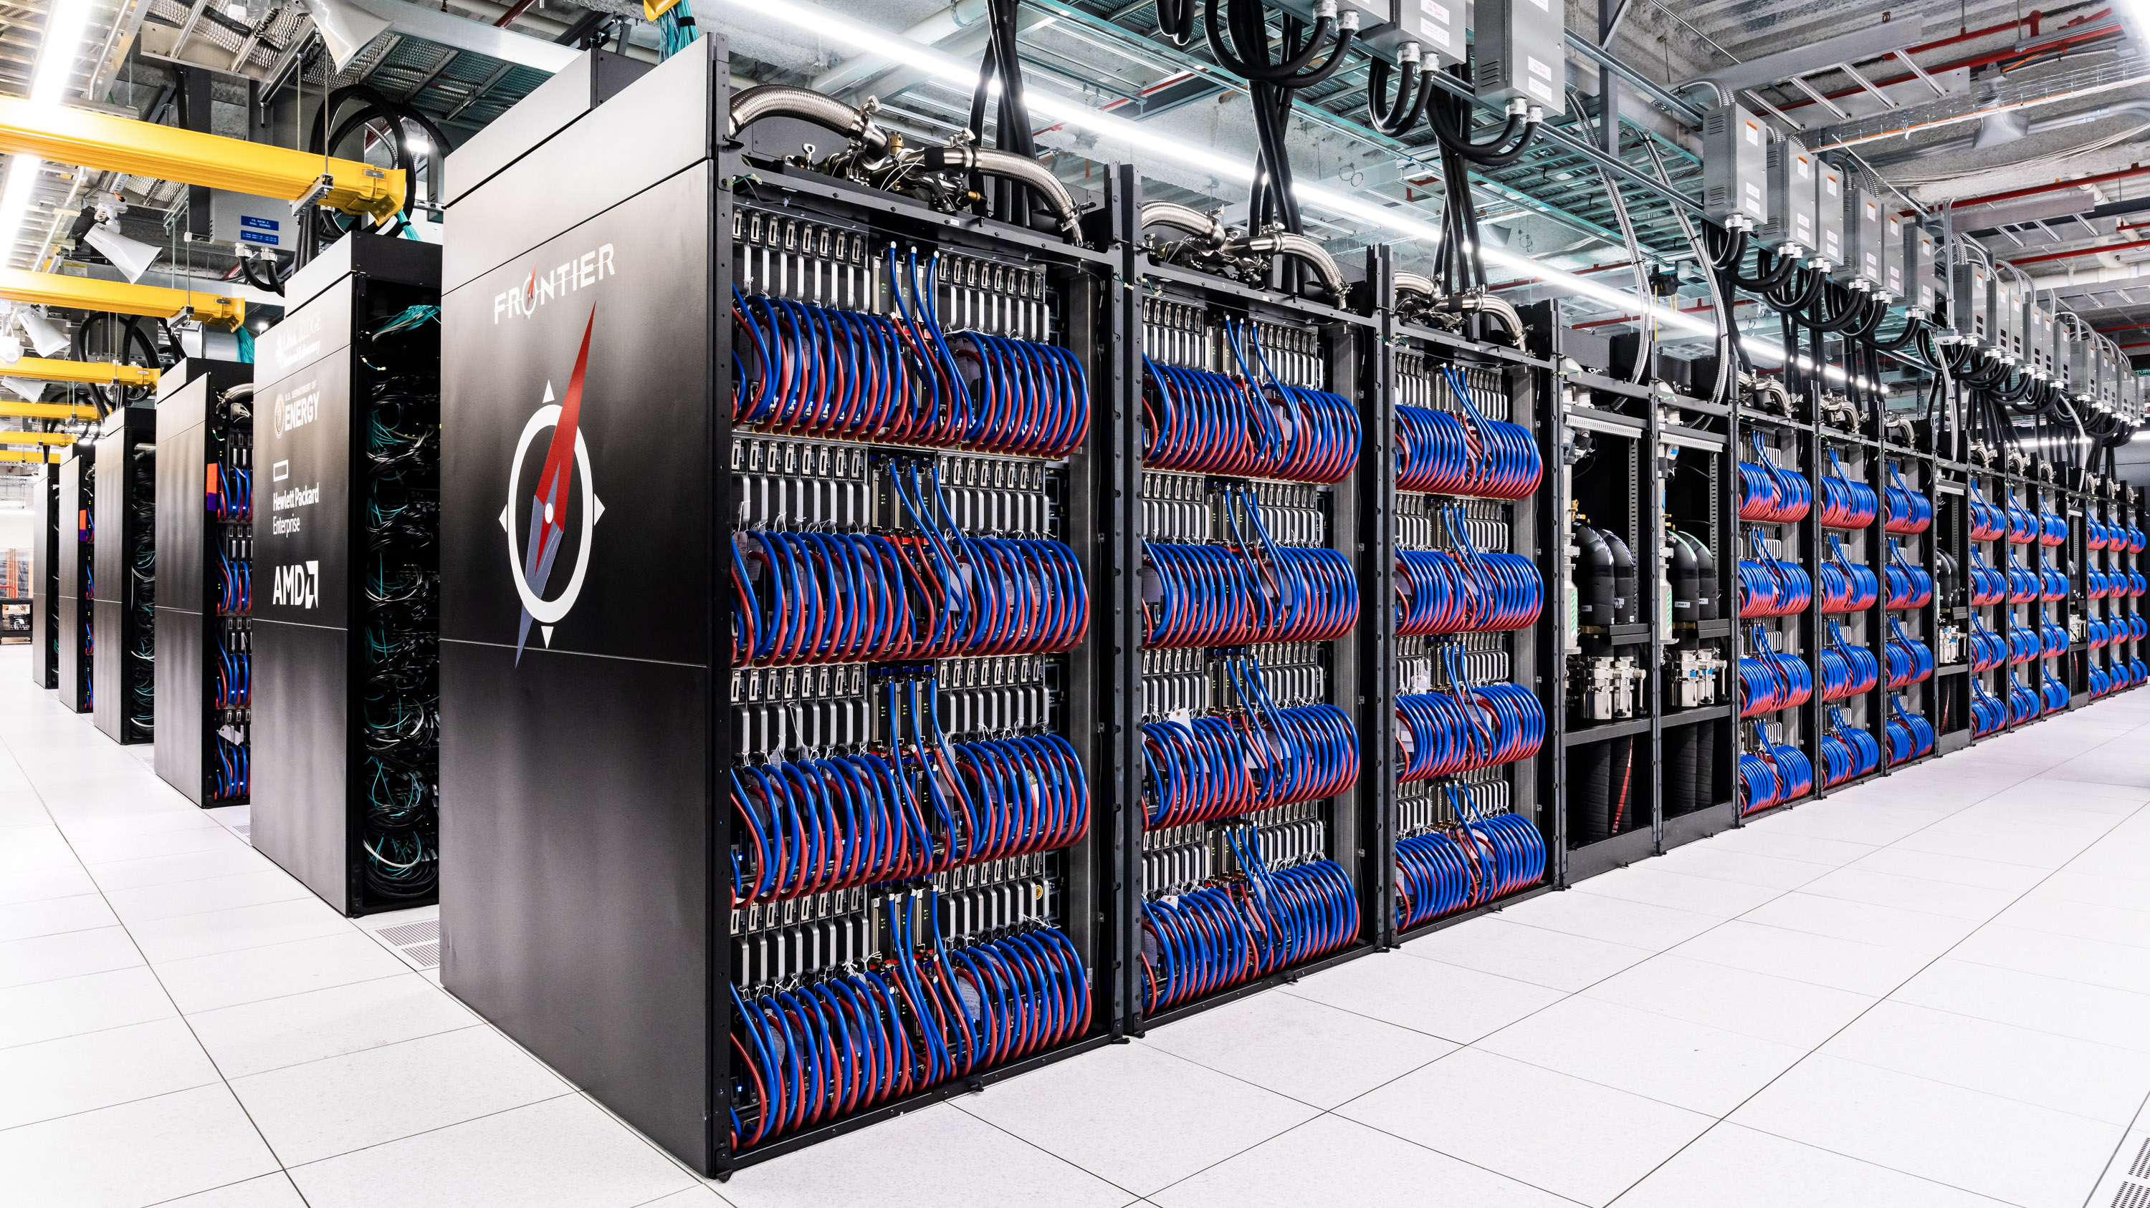
Super Computer

Slide 7
Tools of ICT→ Mobile System
Mobile systems are portable ICT devices like smartphones, tablets, and laptops.
They support wireless communication, making ICT available on the go.
Importance:
Communication: Calls, messaging, video conferencing (WhatsApp, Zoom, MS Teams).
Education: E-learning apps (Google Classroom, Khan Academy).
Business: Mobile banking, digital payments, online marketing.
Entertainment: Games, music, movies, and social media.
Example: Students can attend online classes and submit assignments from anywhere using a smartphone.

Slide 8
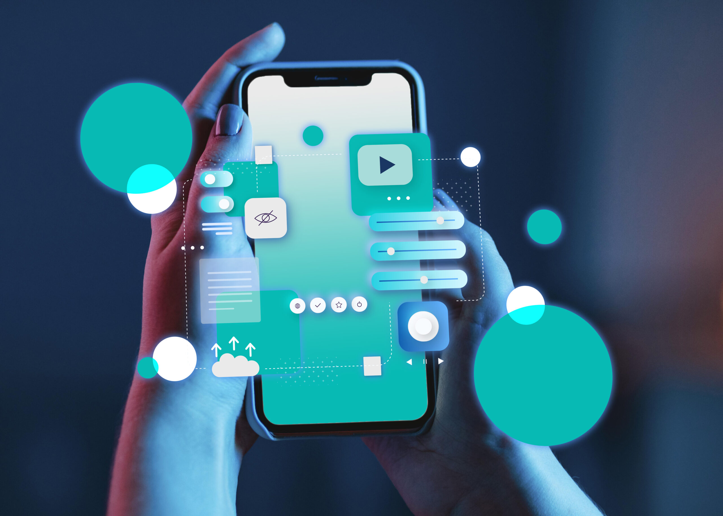
Tools of ICT→ Mobile System

Slide 9
Tools of ICT→ Satellite System
Satellites are devices in space that transmit signals for global communication.
Key roles in ICT:
Telecommunication: Internet, TV, and telephone networks.
Navigation: GPS systems for travel, aviation, shipping.
Weather Forecasting: Helps predict storms, floods, and climate changes.
Disaster Management: Provides communication in areas where normal infrastructure is destroyed (e.g., after earthquakes).
Example: During floods in Pakistan, satellite communication helped in rescue operations.

Slide 10
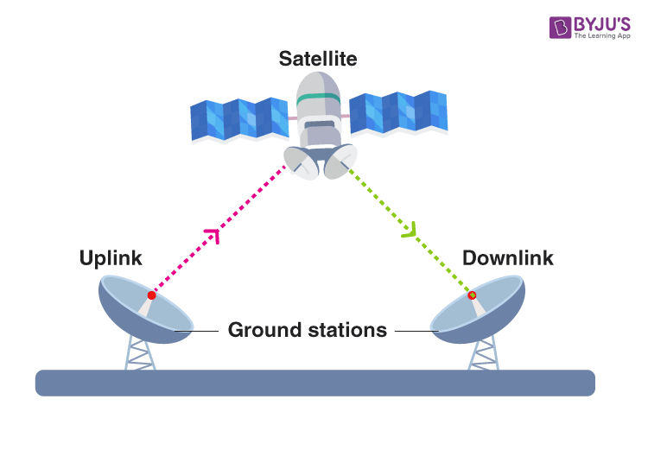
Tools of ICT→ Satellite System

Slide 11
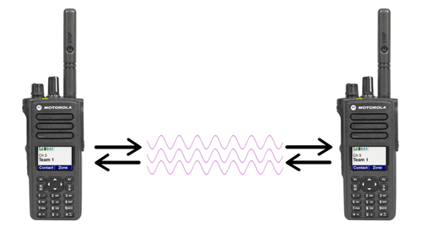
Tools of ICT→ Radio System
One of the oldest ICT tools, still important in the modern world.
Radio system utilizes radio waves to transmit and receive information, enabling various forms of communication like broadcasting, two-way communication, and wireless data transmission.

Slide 12
Tools of ICT→ Radio System
Uses:
Broadcasting news, sports, and educational programs.
Emergency communication in remote or rural areas.
Radio-based education (used in distance learning in many developing countries).
Military communication.
Example: In rural villages, farmers still rely on radio for weather and crop information

Slide 13
1. Introducing to the World of Computers
a) Computers in Your Life
b) What is a Computer and What Does it Do?
c) Computer Users and Professionals

Slide 14
a) Computers in Your Life
At Home: Online shopping, internet browsing, smart home devices (e.g., washing machines with embedded systems).
In Education: Online classes, digital libraries, e-learning tools, virtual labs.
In Jobs/Offices: Word processing, presentations, data analysis, office automation.
On the Go: Cloud storage (Google Drive, OneDrive), mobile computing, GPS navigation.

Slide 15
b) What is a Computer and What Does it Do?
- Electronic device that accepts input, processes data, stores info, produces output
- Basic Functions: Input → Process → Storage → Output
- Example: Online exams (Input answers → Process → Store → Display results)
Notes:
b) What is a Computer and What Does it Do?
Definition: A computer is an electronic device that accepts input, processes it, stores data, and generates output according to instructions (software).
Basic Operations:
Input: Data entered via keyboard, mouse, scanner, etc.
Process: CPU processes the data.
Storage: Temporary (RAM) or permanent (Hard drive, SSD).
Output: Results displayed on screen or printed.
Example: In online exams – student inputs answers → computer processes and stores → results are displayed/output.

Slide 16
c) Computer Users and Professionals
End Users (Consumers): Students, teachers, office workers, etc.
IT Professionals:
Programmers: Develop software.
Network Engineers: Manage communication networks.
Database Administrators: Manage large sets of data.
Cybersecurity Experts: Protect systems from attacks.
Specialists: Data scientists, AI engineers, cloud specialists.

Slide 17
d) Computers to Fit Every Need
Embedded Computers – Small computers built inside devices (microwave ovens, cars, washing machines).
Mobile Computers – Smartphones, tablets, laptops for portable computing.
Personal Computers (PCs): Used by individuals for education, entertainment, and work.
Servers: Provide resources to multiple users (web hosting, cloud storage).
Mainframes: Large computers for banks, airlines, government offices.
Supercomputers: Extremely powerful, used in research labs, weather forecasting, nuclear simulations.

Slide 18
Class Activity
Discussion: Which ICT tool do you use most daily and why?
Quick Quiz:
1. Difference between supercomputer & mainframe
2. Example of embedded system
3. How satellites help in disaster management?
4. Two roles of IT professionals

Slide 19
Conclusion
Conclusion
ICT tools such as computers, mobiles, satellites, and radios have transformed our world by connecting people, enabling learning, and supporting industries.
Computers come in many forms – from small embedded chips to powerful supercomputers – and they play a critical role in every part of life.
Future careers will require a strong understanding of ICT and computer systems.

Slide 20
Assignment # 1
Make a comprehensive report on classification of Computers according to size.
Micro computers
Mini Computers
Mainframe Computers
Super Computers
Submit on the Google Classroom.
Deadline: 27th August 2025 not later than 11:59PM

